Slide 1
Mena Sedky
Data Engineer

Slide 2
About the Project
Context: Simulation of a real-world insurance claims platform.
Goal: Build a data pipeline to process structured and semi-structured insurance data.
Scope
Simulates real-world ETL pipeline for insurance claims.
Cleans & transforms CSV claims/policies data.
Loads structured data into PostgreSQL and semi-structured into MongoDB Atlas.
Automated & orchestrated via Airflow in Docker.
Scalable cloud-based ELT design (AWS)
Supports analytics & reporting use cases.

Slide 3
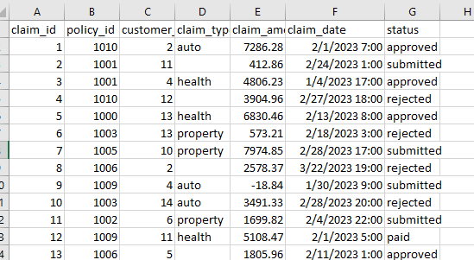
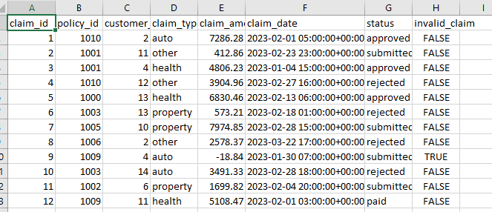
Data Cleaning & Transformation Python Script
Normalize claim_date to UTC
Replace missing claim_type with "other"
Flag invalid claims (claim_amount < 0)
Export cleaned file → claims_cleaned.csv

Slide 4
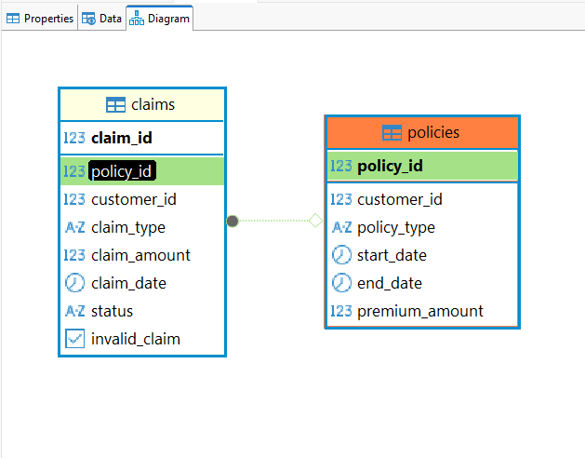
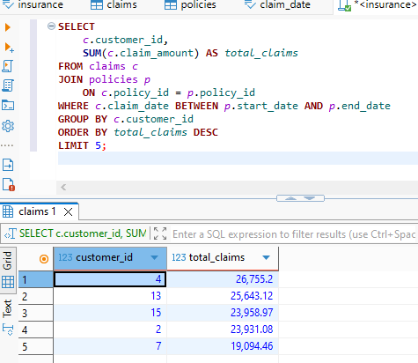
Data Cleaning & Transformation SQL Query
Load claims_cleaned.csv and policies.csv to PostgreSQL
Write a SQL query that returns the top 5 customers with the highest total claim amount in the last 60 days.
All claim dates in the dataset were from 2022 and 2023, so the query was designed to return the top 5 customers by total claim amount.
The query uses a JOIN between claims and policies tables to enrich claims with policy information before aggregation.

Slide 5
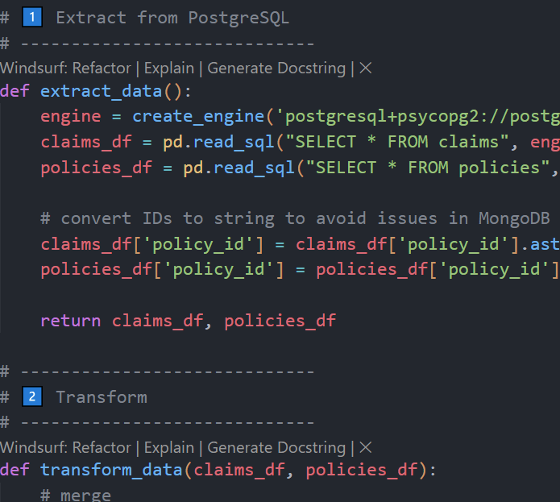
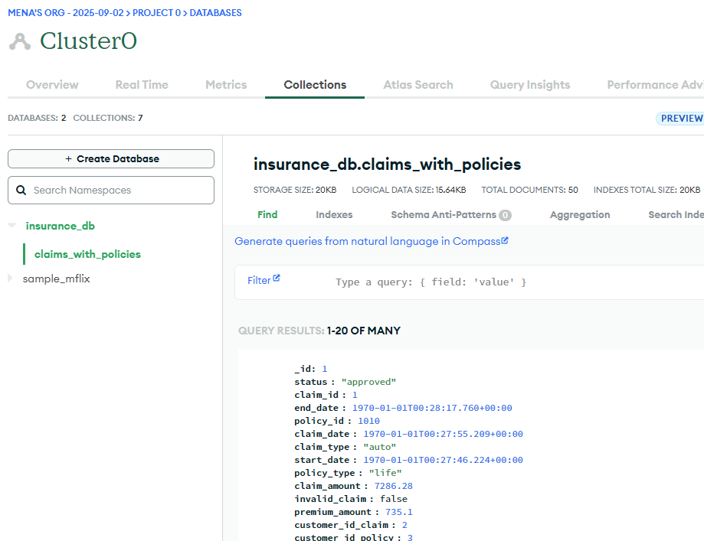
ETL/ELT Pipeline
Extract: Read claims & policies tables from PostgreSQL.
Transform:
Join on policy_id.
Normalize date fields.
Clean nulls & set _id = claim_id.
Load: Insert JSON documents into MongoDB Atlas (claims_with_policies).
✅ Output: Enriched insurance claims stored as semi-structured JSON for analytics.
5

Slide 6
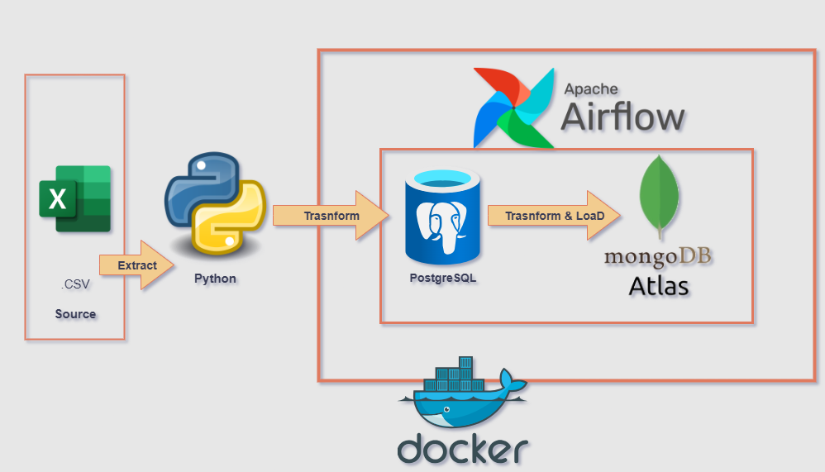
6

Slide 7
Airflow DAG – ETL Claims Pipeline
Import functions &DAG Config
Reuse extract, transform, load logic from external script
Daily schedule, retries, logging, no backfill
Extract
Pull claims & policies from PostgreSQL, push via .xcom
Transform
Join & clean data, convert into JSON records
Load
Add created_at timestamp, insert JSON into MongoDB

Slide 8
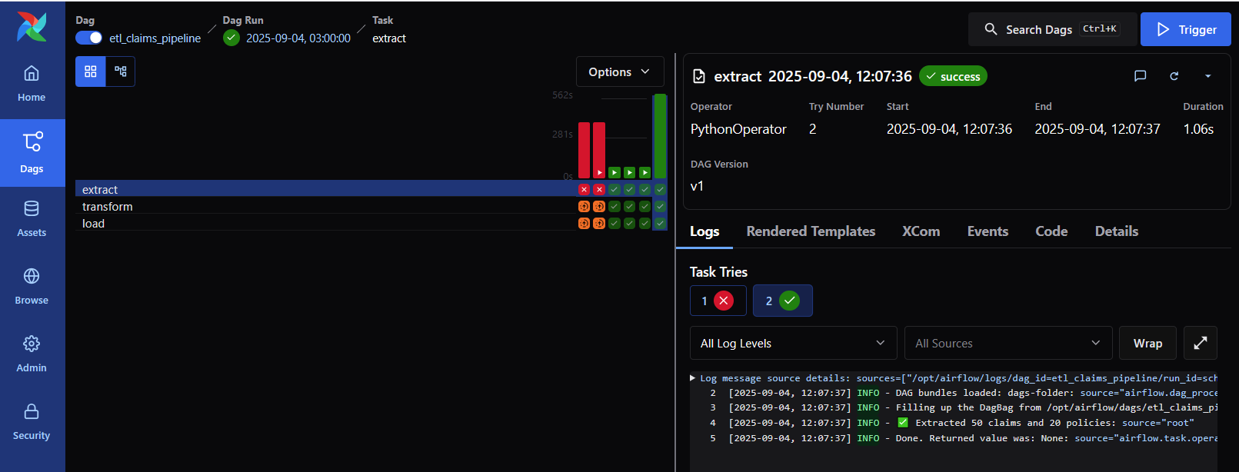
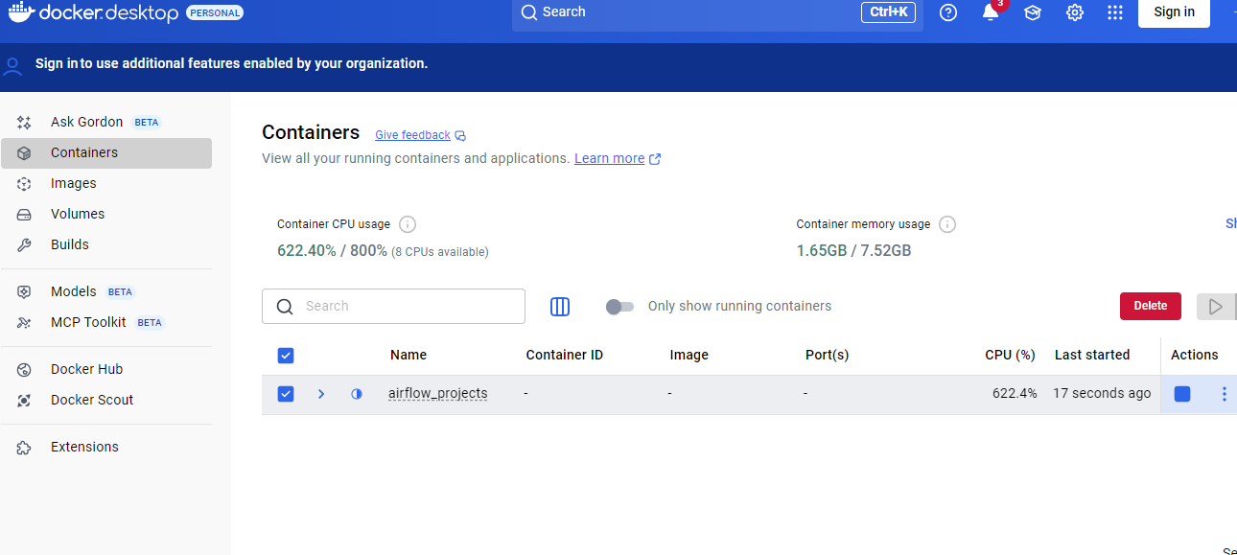

Slide 9
Scalability & Cloud Considerations
File Format & Partitioning
Use Parquet (columnar, compressed, efficient for analytics).
Partition by year/month/day (and optionally by claim_type).
Secondary partition by region or claim_type if queries need filtering
Frameworks / Services
AWS Services
Ingestion: Kinesis Firehose / S3 Put events.
Transform: AWS Glue jobs (serverless Spark).
Analytics: Athena for ad-hoc queries, Redshift for structured warehouse.

Slide 10
Scalability & Cloud Considerations
Monitoring & Data Quality
Cost Optimization (AWS)
Monitoring
Use CloudWatch (AWS) for pipeline metrics.
Glue Job Monitoring Track data latency, failed jobs, throughput.
Data Quality
Implement Great Expectations for automated validation (e.g., no negative claim_amount, date consistency).
Data validation at ingestion (Lambda)
Store validation reports in S3/Blob + SNS alerts on failures.
Storage
Store data in Parquet/ORC (compressed, columnar).
Apply S3 Lifecycle Policies → Glacier / Deep Archive.
Compute
Use Spot Instances for Glue/EMR.
Enable auto-scaling for EMR/Spark jobs.
Query ad-hoc data with Athena (serverless).
Data Warehouse
Use Redshift RA3 nodes + Spectrum.
Enable Concurrency Scaling only when needed.

Slide 11
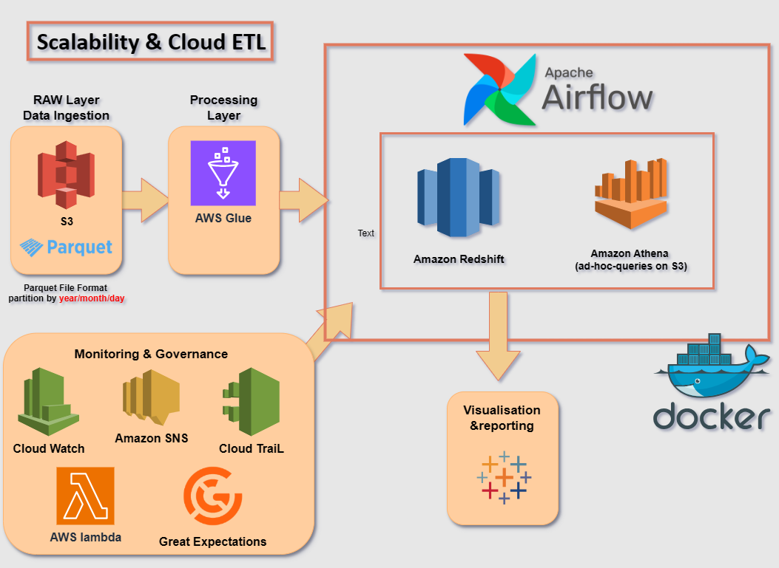
11
11

Slide 12
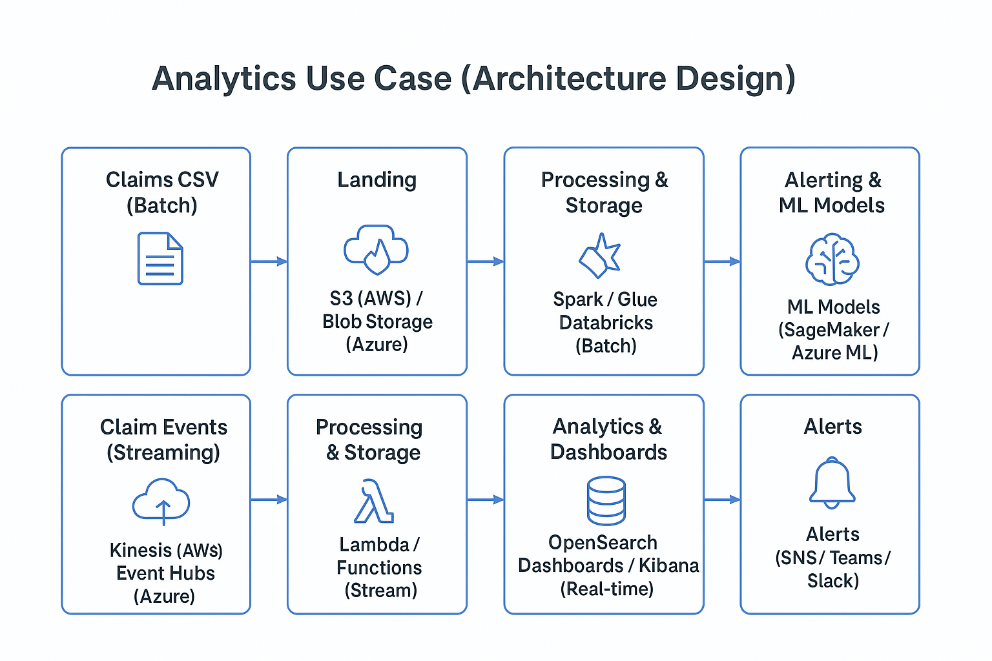
Analytics Use Case (Architecture Design)
Claims department needs dashboards to monitor:
Average claim settlement time
Fraudulent / high-risk claims
Total claims amount per policy type
Architecture must support:
Batch insights (historical reports, trends)
Near real-time insights (alerts, monitoring)
Visualization: Quick Sight / Power BI
Alerts & ML: SageMaker / Azure ML + SNS / Teams

Slide 13
Final Note To be fully honest, I was not able to completely understand the last part on my own, but ChatGPT helped me prepare this. I truly hope to gain more practical understanding of how to perform analytics once I get hands-on experience at work. Thank you for the opportunity.
Mena Sedky
menasedky22@gmail.com
www.linkedin.com/in/menasedky22
+201288923610
https://github.com/menasedky22/insurance-claims-pipeline

